Slide 1
Goals for this session
Share what we’ve learned regarding Charleston’s housing situation
Present draft recommendations and gather feedback

Slide 2
Introduction to Housing Analysis

Slide 3
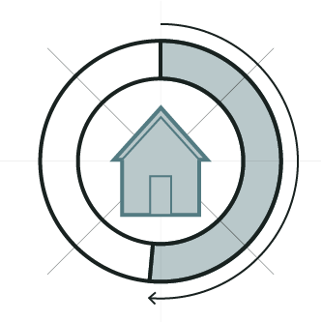
HOUSING ELEMENT
What is the state of our current housing stock – by location, type, age, condition, owner and renter occupancy, and affordability
What are the current and future housing needs?
In what ways are we hindering the creation of affordable housing?
How can we encourage affordable housing development?

Slide 4
WHAT IS AFFORDABLE HOUSING?
AFFORDABLE TO WHOM?
“Affordability” is usually categorized by percentage of the Area Median Income or (AMI).
(Calculated using incomes from across the region, not just the City of Charleston).
30% AMI = $17,050
60% AMI = $34,020
80% AMI = $45,400
Area Median Income (AMI) = 56,700
120%% AMI= $68,040
These numbers reflect annual incomes for a single-person household and are based on the numbers published by the Department of Housing and Urban Development (HUD) for the 2020-2021 fiscal year.
The standard definition for affordable housing is when housing expenses add up to 30% or less of a household’s annual income (BEFORE TAXES).
$
$
$
Add blurb from infographic: “what do we mean by affordable housing?”

Slide 5
DEPARTMENT OF HOUSING & COMMUNITY DEVELOPMENT
CITY OF CHARLESTON HOUSING AUTHORITY
Administers funding from various sources to increase the supply of affordable housing and improve quality of life for low- to moderate-income families and individuals.
Administers the local public housing and voucher-assisted housing programs funded by the Department of Housing and Urban Development (HUD), to provide housing for low- and very low-income families and individuals.
WHO DOES WHAT
DEPARTMENT OF PLANNING, PRESERVATION & SUSTAINABILITY
Regulates the location and type of housing through the zoning code. Can contribute to an increase in for affordable housing by creating incentives for developers, charging development fees to fund affordable housing, and minimizing regulatory burden.
AFFORDABLE HOUSING CREATION AND PRESERVATION

Slide 6
HOUSING ANALYSIS
Community Data Platforms
Housing Labs

Slide 7
Questions/Thoughts

Slide 8
KEY FINDINGS CITYWIDE (infographics)

Slide 9
Questions/Thoughts

Slide 10
Community input & Draft Recommendations

Slide 11
Housing-related Recs in other Plan Elements
Increase residential density and develop Transit-oriented Development (TOD) strategies along the future Lowcountry Rapid Transit route and other key public transit corridors. (Land Use)
Create in-town job centers along key transit corridors in the city. (Land Use)
Make best use of high land around the city for residential, commercial and mixed use development, especially areas around current or future public transit corridors. (Land Use)
Reduce densities on low ground, and eliminate development in future marsh migration areas. Adapt and defend structures currently in these areas wherever feasible. (Land Use)
Identify and protect historic African American Settlement Communities around the city through planning and development policies. (Cultural Resources)

Slide 12
Group Discussion

